Slide 1
The Future of the Firm This is Not Business as Usual
www.joshbersin.com
Josh Bersin
Global Industry Analyst March, 2019
@Josh_Bersin

Slide 2
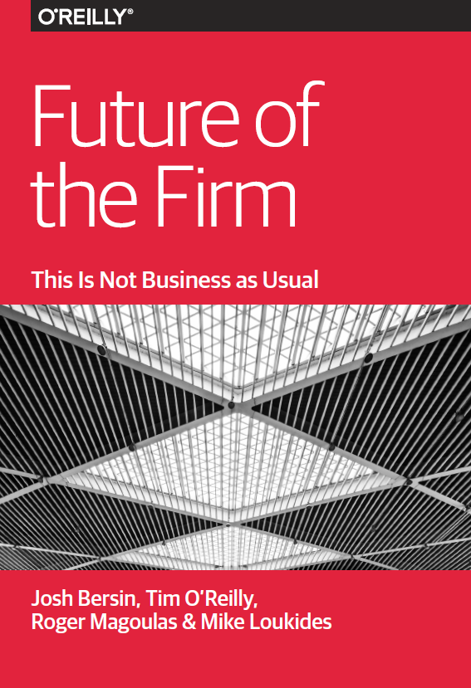
The Future of the Firm Are You Ready?
Trust, Responsibility, Credibility, Honesty, and Transparency
The Search for Meaning
New Leadership Models and Generational Change
Big Systemic Thinking
New Kinds of Partnerships Between People and Machines
From Hierarchies to Networks
Free Agency, Personal Brands, and the Evolving Employer/
A New Employee Relationship
Compensation Beyond Pay
Diversity, Inclusion, and Fairness at Work
Board Governance and Diversity
https://www.oreilly.com/business/free/future-of-the-firm.csp

Slide 3
1
A New World of Work
Talent in The Age of Machines
3

Slide 4
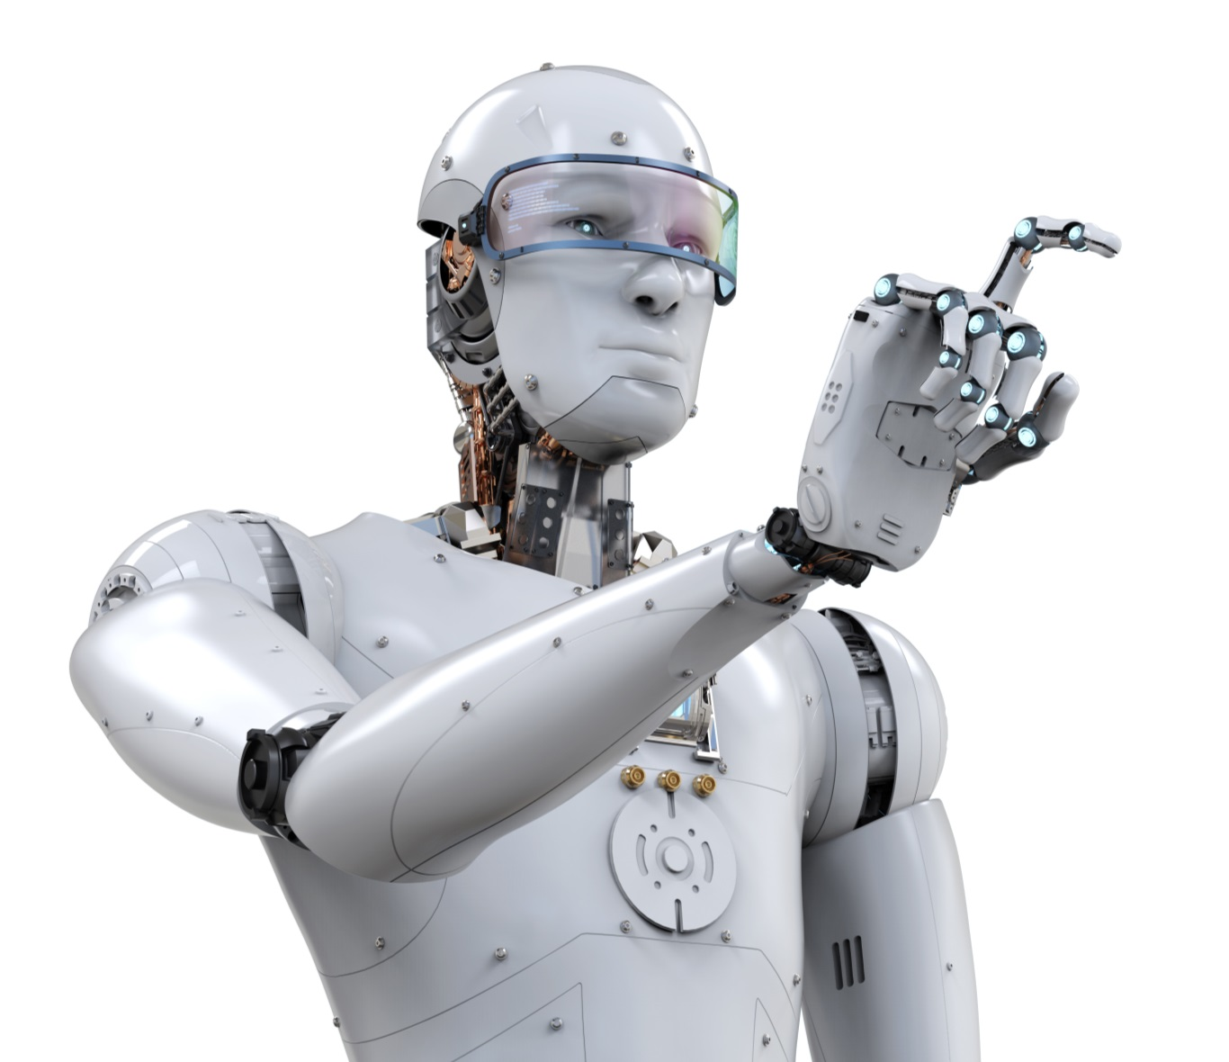
The Robots Have Arrived
41%
Of companies are already implementing automation across multiple functions and 9% enterprise-wide.
83%
of CEOs
only 24%
expect the role of AI, Robotics, and automation to “increase significantly” over the next 2 years.
See jobs going away, yet 83% see demand for new skills or new jobs as a result.
Source: Robots: The new low-cost worker, Dhara Ranasinghe, CNBC, April 10,2015. https://www.cnbc.com/2015/04/10/robots-the-new-low-cost-worker.html
Source: China Can’t Buy Enough Industrial Robots, Jethro Mullen, CNNTech, June 23, 2016 http://money.cnn.com/2016/06/23/technology/china-industrial-robots/index.html

Slide 5
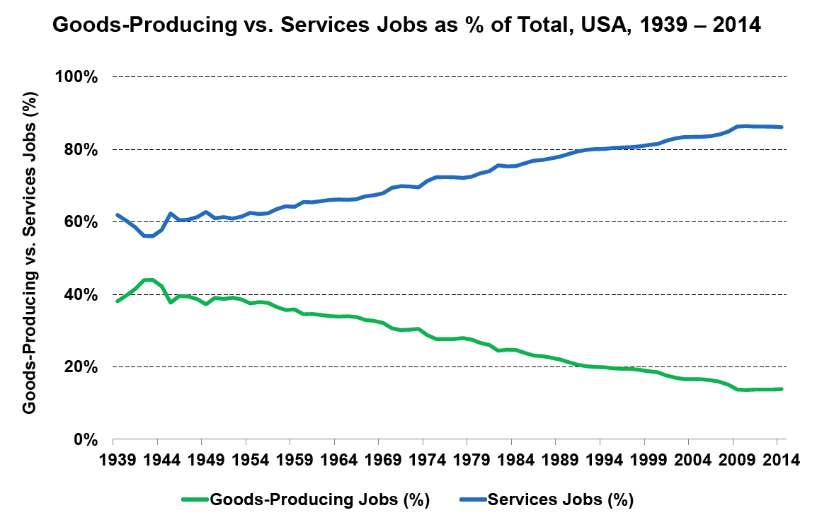
Digital Means Shift To Service-Based Economy
Gap Widening
Source: U.S. Bureau of Labor Statistics

Slide 6
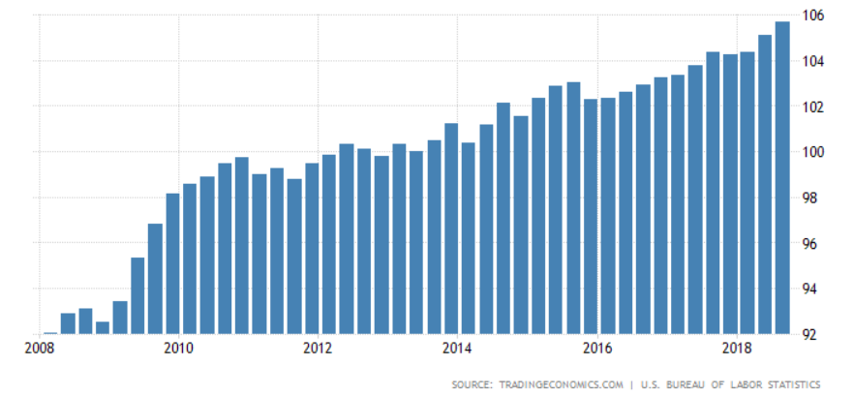
History of Workforce Productivity
US Non Farm Labor Productivity
Historically productivity is slowing
Source: U.S. Bureau of Labor Statistics
iPhone Launched
100 Million Twitter Users
1 Billion Smartphones

Slide 7
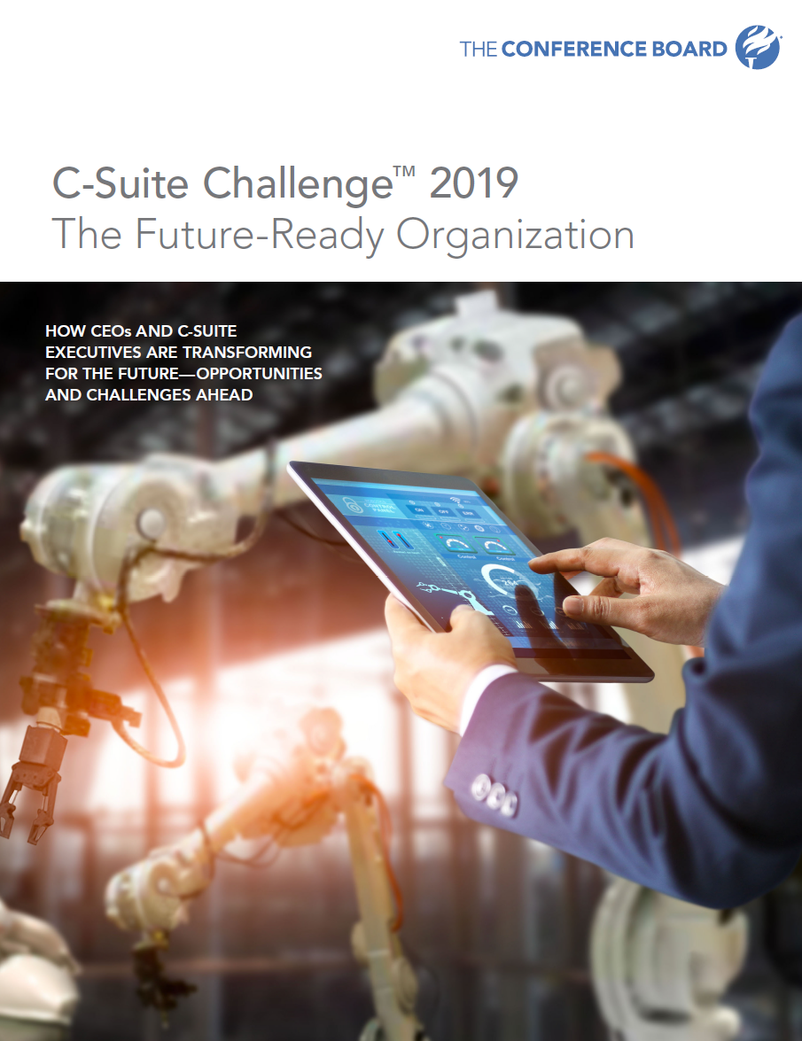
CEO’s Perspective: Talent Critical To Success
External Issues
Risk of recession 44%
Political instability 39%
New competitors 29%
Declining trust 28%
Internal Issues
Attracting and retaining talent 62%
New digital business models 52%
Developing next gen leaders 41%
Aligning comp with performance 28%
Reducing cost 22%

Slide 8
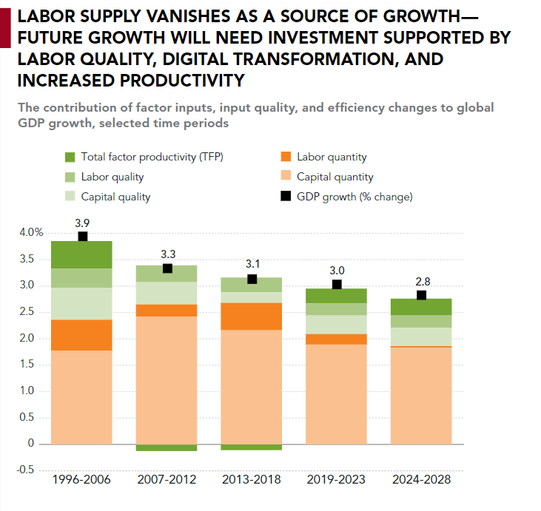
Economic Growth Must Now Be Driven By Productivity
PWC and Conference Board see economic slowdown in US, Europe and China to 3% or lower.
All major economies see shrinking population: US Birth Rate now at 1.7, UK is 1.8, Germany is 1.5, Japan is 1.4
Lower birth rate will create a shortage of workers, forcing companies to grow through “increased productivity and quality of labor.” (read “skills”)
HR leaders will rule. Engagement, productivity, and learning will be the growth drivers for the future

Slide 9
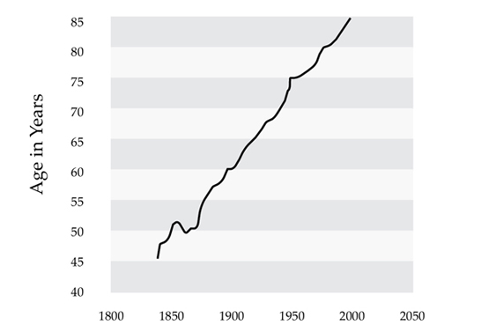
The Longevity Dividend
“Since 1840 there has been an increase in life expectancy of three months for every year.”
Gratton, Lynda; Scott, Andrew. The 100-Year Life
Today’s US fertility rate is 1.7, unable to replace the workforce we have
Increase in Life Expectancy Over Time
http://www.mortality.org/

Slide 10
The Alternative Workforce Isn’t Alternative Any More
Since 2000 the number of US W-2’s dropped by 4%. The number of 1099’s has gone up by 23%.
WeWork adds 650,000 square foot of working space every month with over 500 locations. WeWork revenues went from $900M to $2.6 B in 2018.

Slide 11
2
Employee Experience: Anxious and Stressful
11

Slide 12
Employee Time Famine
The “average” US worker now spends 25% of their day reading or answering emails
The average mobile phone user checks their device 150 times a day.
More than 80% of all companies rate their business “highly complex” or “complex” for employees.
40% of the US population believes it is impossible to succeed at work and have a balanced family life.
Fewer than 16% of companies have a program to “simplify work” or help employees deal with stress.
The “average” US worker works 47 hours and 49% work 50 hours or more, 20% at 60+ hours
49% of workers would rather have more time than more money
Sources: Deloitte Human Capital Trends 2014 and 2015, Edelman trust index 22019

Slide 13
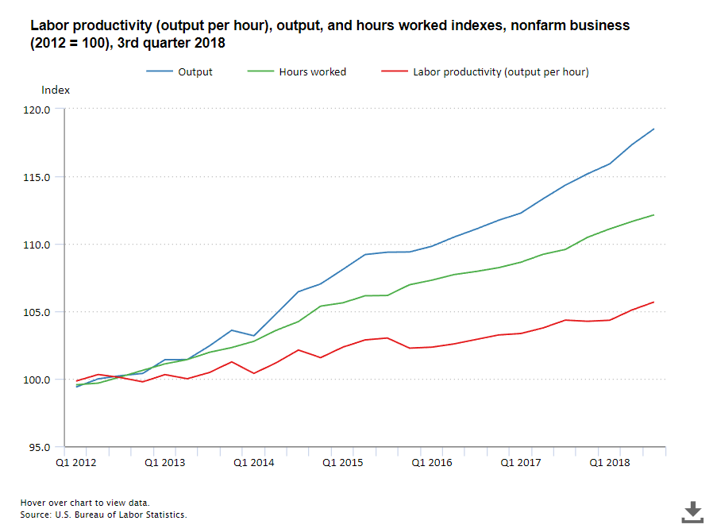
GDP Growth with Low Productivity Creates Stress
GDP or Output
Hours Worked
Productivity
All industries
Productivity
Manufacturing

Slide 14
Wellbeing: A Vacation Crisis
35% of Millennial women feel guilty about taking time off
(25% of men)
Since 2000, US workers lost an entire week of vacation, dropping average vacation days from 20.3 to 16.8
Americans left 662 million unused vacation days forfeiting $66 billion in benefits
39% “want to be seen as a work martyr” to their boss, yet these over-workers are less likely to receive a promotion or raise than their peers.
Employees who forfeit time are less likely than non-forfeiters to be promoted or receive a raise or bonus
Source: The State of American Vacation 2018, Project: Time Off https://www.projecttimeoff.com/state-american-vacation-2018

Slide 15
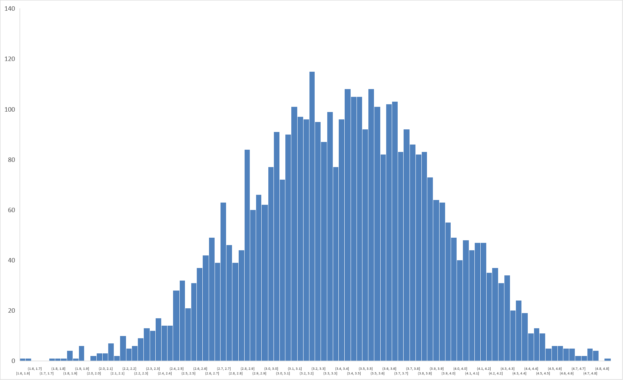
Engagement Increasing, But Still A Challenge
Average 3.38
The Escalating War for Talent 2016: 3.11
2017: 3.22
2018: 3.38
8.7% increase in three years

Slide 16
3
A Learning Renaissance .. In The Flow of Work
16

Slide 17
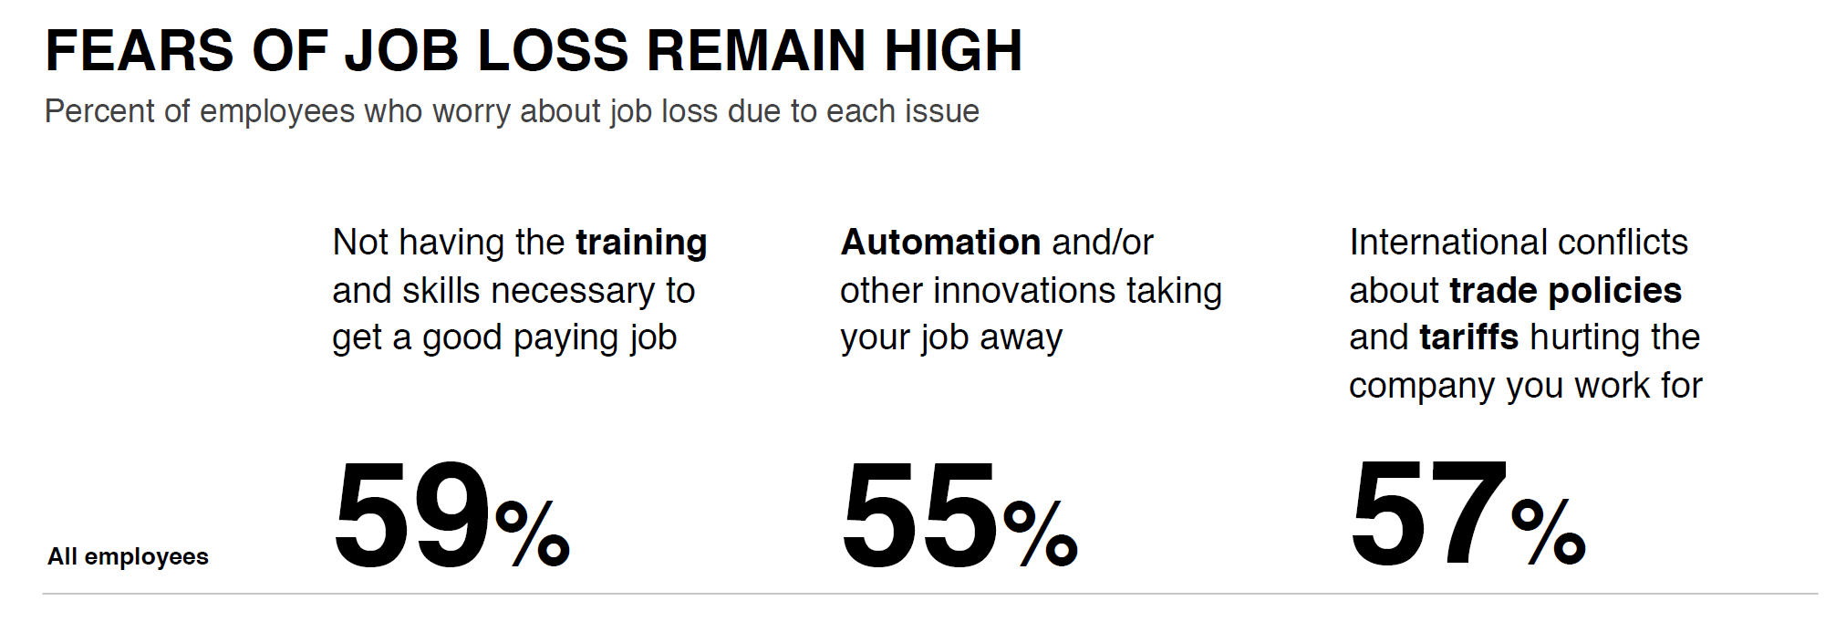
Employees’ Rising Skills Anxiety

Slide 18
New Skills And Jobs More “Hybrid” Than Ever
Most In-Demand Skills
Management
Sales
Communication
Marketing
Start-ups
Python
Software development
Analytics
Cloud computing
Retail
Most In-Demand Capabilities
Adaptability
Culture fit
Collaboration
Leadership
Growth potential
Prioritization
Soft Skills
Tech
https://economicgraph.linkedin.com/research/LinkedIns-2017-US-Emerging-Jobs-Report

Slide 19
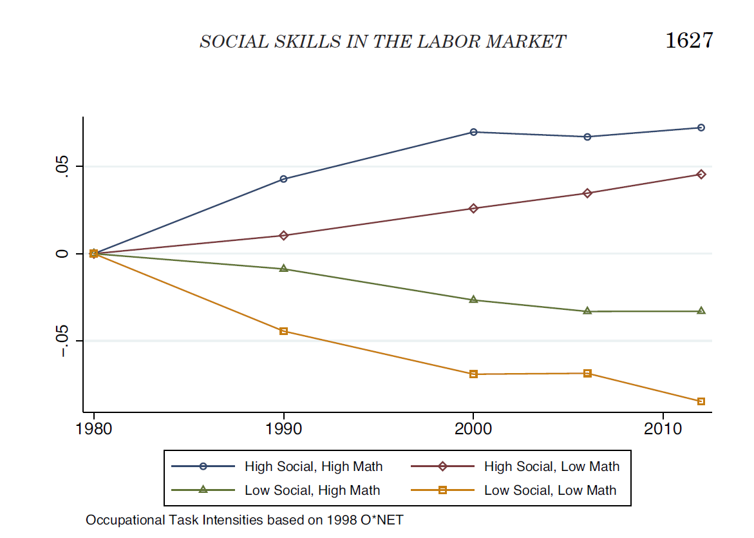
Increasing Wages and Demand for Soft Skills
Growth in Wages and Demand1980-2012

Slide 20
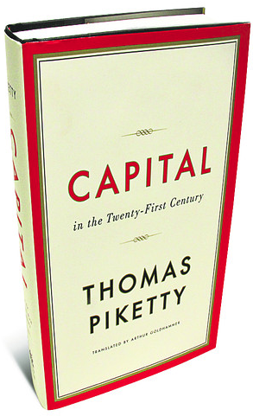
The Learning Curve Is The Earning Curve
“Over 300 years of economic history, the principal and most enduring mechanism for distribution of wealth and reduction in inequality is the diffusion of skills and knowledge.”

Slide 21
Learning Is Now The Most Important Thing
N=2,800 professionals, Fall 2018, Bersin and LinkedIn Research,
https://www.linkedin.com/pulse/want-happy-work-spend-time-learning-josh-bersin/

Slide 22
Every Company Is Reskilling … All The Time
Upskilling
Reskilling
Reinvention
Our software engineers need to shift to agile development methodologies.
Our sales teams need to learn to use Salesforce for account development.
Our marketing teams need to learn digital marketing and analytics tools like Marketo
Our software engineers need to shift from client/server to mobile or cloud development.
Our sales teams need to understand integrated vertical solutions
Our marketing teams need to learn SEO and digital advertising tools.
Our software engineers need to learn AI, nudges, and gamification models.
Our sales teams need to become consultants and advisors.
Our marketing teams need to shift to product management and design thinking.
Productivity
Innovation and Growth
Survival

Slide 23
4
The End of Hierarchy Agile Goes Mainstream
23

Slide 24
And organizations must redesign themselves
A network of teams
A
B
C
D
E
B
A
Shared values and culture
Transparent goals and projects
Free flow of information and feedback
People rewarded for their skills and abilities, not position
C
D
F
G
E
How things were
How things “are”
How things work
Source: Rewriting the rules for the digital age. 2017 Deloitte Global Human Capital Trends

Slide 25
Agile Has Taken Off
Agile
Scrum
OKR

Slide 26
Agile Org Models Have Arrived: And They Work
35% of companies are now
Fully or mostly team-based
More than half see significant performance improvement
2019 Deloitte Human Capital Trends, n=1,200+ organizations, publishing in 2019

Slide 27
A New Model for Careers
Traditional
Today
Career development means upward progression
Career development means growth through new experiences
New positions are offered to me
I seek out and find new opportunities
My manager helps me plan my career
My manager, mentor, and others help me find job opportunities
Development focuses on senior leaders
Development is available to
everyone
My manager decides when I am ready for a new position
I decide when I’m ready to change roles
Taking a new assignment can be risky
Moving to a new position is respected and considered key to growth

Slide 28
Need For New Career Models
Society’s Needs and Demands
Succession management
Career development
Organization needs
Individual needs/desires
Values
Strategic initiatives
Desired business outcomes
Desired competencies (knowledge, behavior, skills)
Open positions & opportunities
Individual
Development
Plan (IDP)
Annual goals
Development needs
Mobility
Strengths
Career aspirations
Mission
Vision
Strategic competencies
Workforce
planning
Development planning
Performance management

Slide 29
5
An Intense Thirst for Trust
29

Slide 30
Trust Is The New Business Currency
Edelman Trust Data
Majority believe the system is failing:
46% Believe
Only 48%
Yet
75%
The system is failing me
Trust government
Trust my employer
https://www.edelman.com/research/2019-trust-barometer-global-results

Slide 31
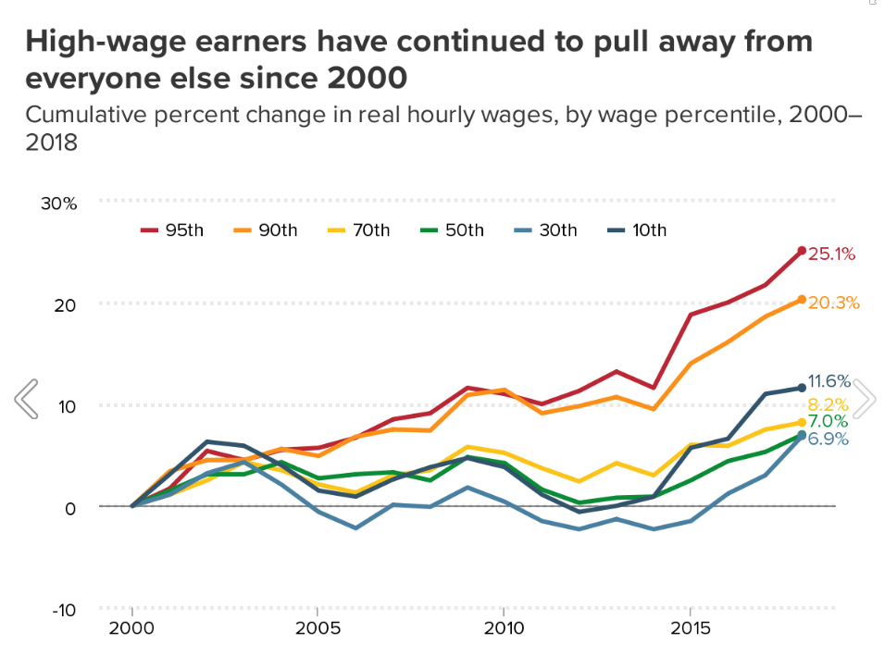
Income Inequality Accelerates
Over the last 30 years in the US, growth in the incomes of the bottom 50% has been zero, whereas incomes in top 1% have grown 300%
Eight men now own the same amount of wealth as the poorest half of the world

Slide 32
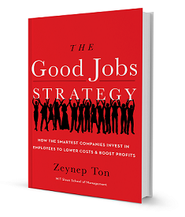
Time To Talk about CEO vs. Employee Wages Too
Average US firm CEO pay is 312X median employee pay (November, 2018)
In the largest corporations, the top five officers capture 12% of all annual profits
Four out of six CEOs believe that their top execs are overpaid relative to their performance
Increasing pay in front-line positions directly increases sales and productivity (retail, hospitality, Zeynep Tom)
“Our research showed that after analyzing two years of data from 500 stores, an increase of $1 in payroll increases sales by $4-28 and profit exceeds expense by 40%.”
Lucien Bebchuk and Yaniv Grinstein, “The Growth of Executive Pay,” NBER Working Paper 11443
Francesco Guerrera, “We Are Overpaid, Say US Executives,” Financial Times, October 14, 2007

Slide 33
How Economic Values Have Changed
51% of Millennials have a positive view of Socialism
45% of Millennials have a positive view of Capitalism (drop of 12% in two years)
Over all ages, 56% of Americans favor capitalism (drop from 61% in 2010)
 | 2016 | 2018 | % change
Favor Capitalism | 60% | 56% | + 7%
Favor Free Enterprise | 85% | 79% | + 7%
Favor Big Business | 53% | 50% | - 6%
Believe in Socialism | 35% | 37% | + 6%
Trust Federal Government | 44% | 39% | - 11%
https://news.gallup.com/poll/240725/democrats-positive-socialism-capitalism.aspx

Slide 34
The Case for Social Capital: World Happiness Research
Research shows need for social cohesion, relationships, and trust
 | Happiness Index (1-10) | Health: Life expectancy | Income per Capita | Social Support | Trust In Institutions
United States 2006 to 2016 | -5.6% | +1.6% | +0.3% | -6.2% | -16.1%
Nordics vs. US | 10.9% | +0.1% | -1.1% | +5.6% | +48.6%
“During my years caring for patients, the most common pathology I saw was not heart disease or diabetes; it was loneliness. Today 40% of adults in America report feeling lonely.”
-Former Surgeon Admiral Vivek Murthy
Source: World Happiness Report, 2018, Heliwell, Sacks, Layard, Cantril Ladder Methodology September 2017 Harvard Business Review, “Work and the Loneliness Epidemic”

Slide 35
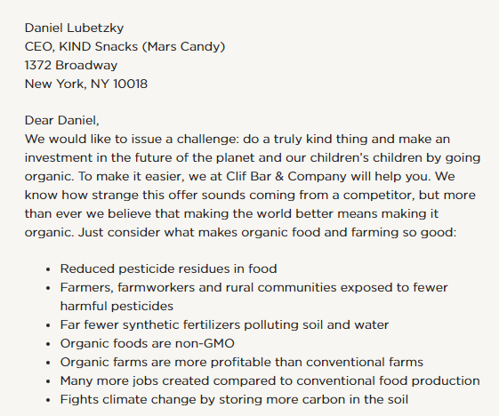
The War for Purpose Rages

Slide 37
6
How Can
Technology Help?
37

Slide 38
Distrust & Backlash Against Technology
60% of Californians believe tech benefits the state, yet
only 38% believe tech benefits me
Over 3/5 of Californians believe tech firms over-focus on profits and are draining local resources for their own benefit
58% believe tech has failed to protect them from data security threats
Only 29% believe tech is being transparent and open and 67% believe the industry is “secretive.”
Edelman trust index, California edition, https://www.edelman.com/2018-california-trust-barometer

Slide 39
Shift To Technology That Makes Work Easier
Automated Talent Management
Integrated Talent Management
Engagement, Fit,
Culture, Analytics
Productivity, Performance, Teams
People Management: Focus on culture, engagement, environment, leadership, and fit
Team & Work Management: Optimizing productivity, alignment, and teams to make work better.
Talent Management: Integrated processes and systems, Talent as core to HR and business agenda
Systems of Automation
Practice-driven solutions
Systems of Engagement, Empowerment solutions
Systems of Productivity In the Flow of Work
Automate
Integrate
Engage
Engage
Perform
1990s-2000s
2004-2012
2012-2017
2019+

Slide 40
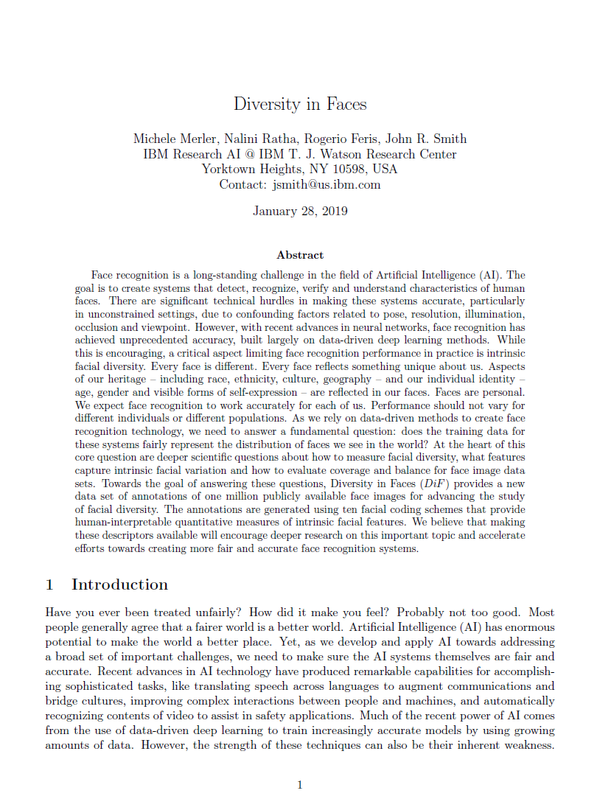
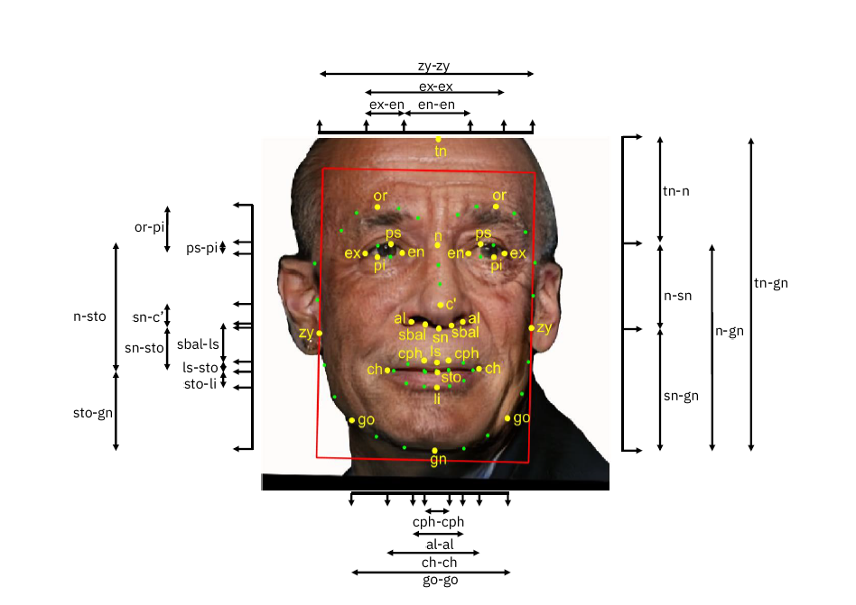
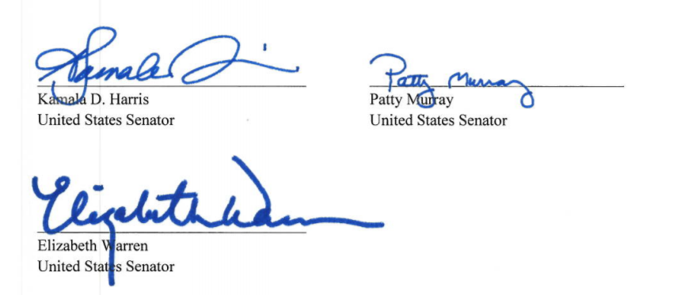
Is AI Becoming Dangerous? 68 Dimensions Of Facial Recognition

Slide 41
Responsibility and Ethics with AI and Data
Privacy
Security
Bias
People Impact
Is my information private?
Do I know what information is captured?
Can I see the information?
Can I edit or repair information that is incorrect?
Can I be forgotten?
What happens if it is leaked?
Is the information encrypted and secure?
Who has access to seeing it?
What are the cyber protections?
What rights do I have for damages if lost?
Does the organization hold itself accountable?
How will my age, gender, race, education, degree, and other demographic information be used?
What safeguards and processes are there to remove bias?
Is the AI auditable?
What studies and tools can I see?
Is this information being used to save money or reduce costs?
How will this make people’s work life better?
How will this improve customer satisfaction?
How will this make the workplace or team better?
Facebook
CVS
Yahoo
Vizio (TV Sets)
Ashley Madison
Marriott: 500+ Million
Equifax: 147 Million
Under Armor: 150 Million
Target: 110 Million
Quora: 100 Million
Facebook: 50 Million
Amazon – hiring
Credit scores – Experian
Police images – Implicit bias
Mortgages
Everyone?

Slide 42
7
What Can
We Do?
42

Slide 43
A New Paradigm For Management
The Industrial
Corporation
Hierarchical
Leadership
Collaborative
Management
A Networks of Teams
The Trusted Enterprise
Operational
Efficiency
Profit, Growth,
Financial Engineering
Customer Service,
Employees as Leaders
Mission, Purpose,
Sustainability
Citizenship, Trust, Growth, Learning
Industrial Age
People as Workers
Management by
Objective
Servant Leadership
Work Together
Empower the
Team
Productivity, Wellness, Responsibility
Andrew Carnegie Henry Ford
Jack Welch
Peter Drucker
Howard Schulz
Steve Jobs
Netflix, Google,
Facebook, Amazon
Unilever, Allbirds,
Patagonia, Whole Foods
The Corporation
is King
The Executives
are King
The People are
King(s)
The Teams and
Team Leaders are Kings
The Individual, Community, and Team
<1950s
1960s-80s
1990s
Today
2020

Slide 44
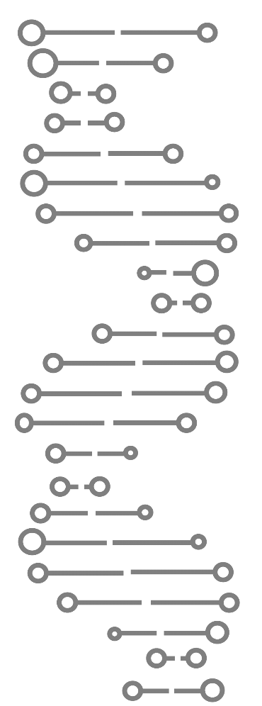
New Breed of Leadership
Continuously innovating
Real time & on-demand
Ongoing shifts in decision rights and power
Modulating risk & security boundaries
Fluidity
Geography agnostic
Like human DNA, Digital DNA carries the 23 underlying instructions, development, functioning, and replication for being “digital’.
These are expressed as digital traits and characteristics. They are present in all areas of the organization: business models, operating models, customer interaction, organization structure, talent, technology, cyber-security, culture, etc.
There are four levels of Digital Maturity: Exploring, Doing, Becoming, and Being.
Morphing team structures
Intentionally collaborative
Dynamic skill requirements
Changing nature and typology of work
Constant disruption
Increased customer involvement
Democratizing information
Multi-modal operations
Uneven velocity between digital & legacy
Productive mobility (non-traditional workspace options)
Changing mix of traditional & non-traditional stakeholders
Flattening and changing hierarchy
Agility
Continuous ecosystem disruption
Constantly changing decision criteria
Source: 2017 Bersin Predictions, Deloitte Digital DNA
Fail early, fail fast, learn faster
Iterative

Slide 45
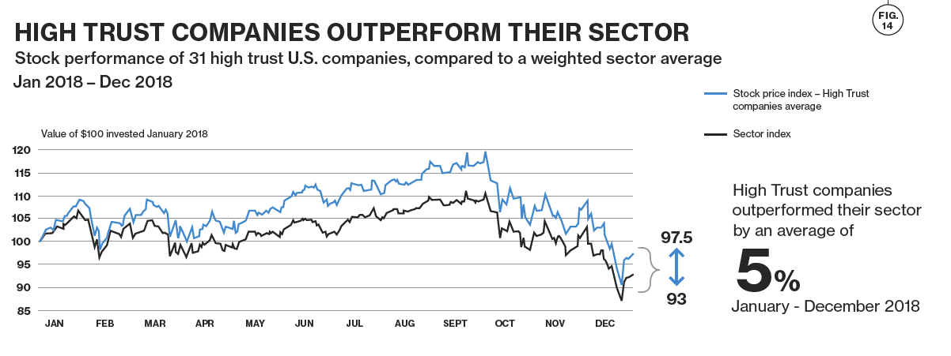
In Today’s Economy, Trust Pays Off

Slide 46
The Future of the Firm Are You Ready?
Trust, Responsibility, Credibility, Honesty, and Transparency
The Search for Meaning
New Leadership Models and Generational Change
Big Systemic Thinking
New Kinds of Partnerships Between People and Machines
From Hierarchies to Networks
Free Agency, Personal Brands, and the Evolving Employer/
A New Employee Relationship
Compensation Beyond Pay
Diversity, Inclusion, and Fairness at Work
Board Governance and Diversity
https://www.oreilly.com/business/free/future-of-the-firm.csp

Slide 47
2019: A Year To Take Action Get ready for the Future of the Firm – it’s here now.
www.joshbersin.com/predictions

